Slide 1
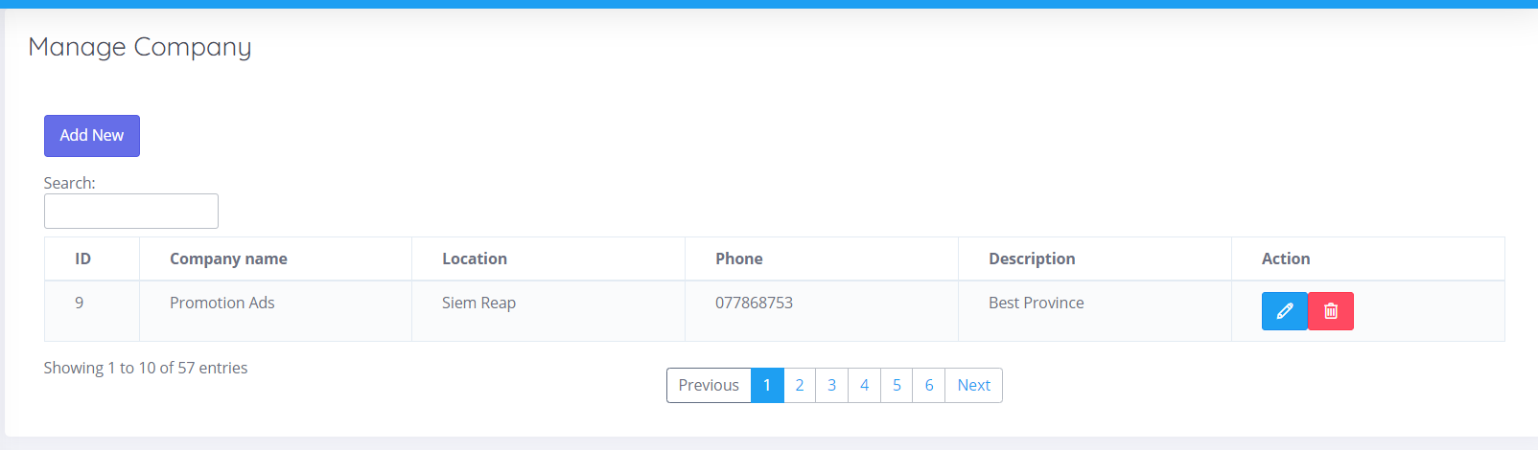
Configuration
Company
Manager
Location
Brand

Slide 2
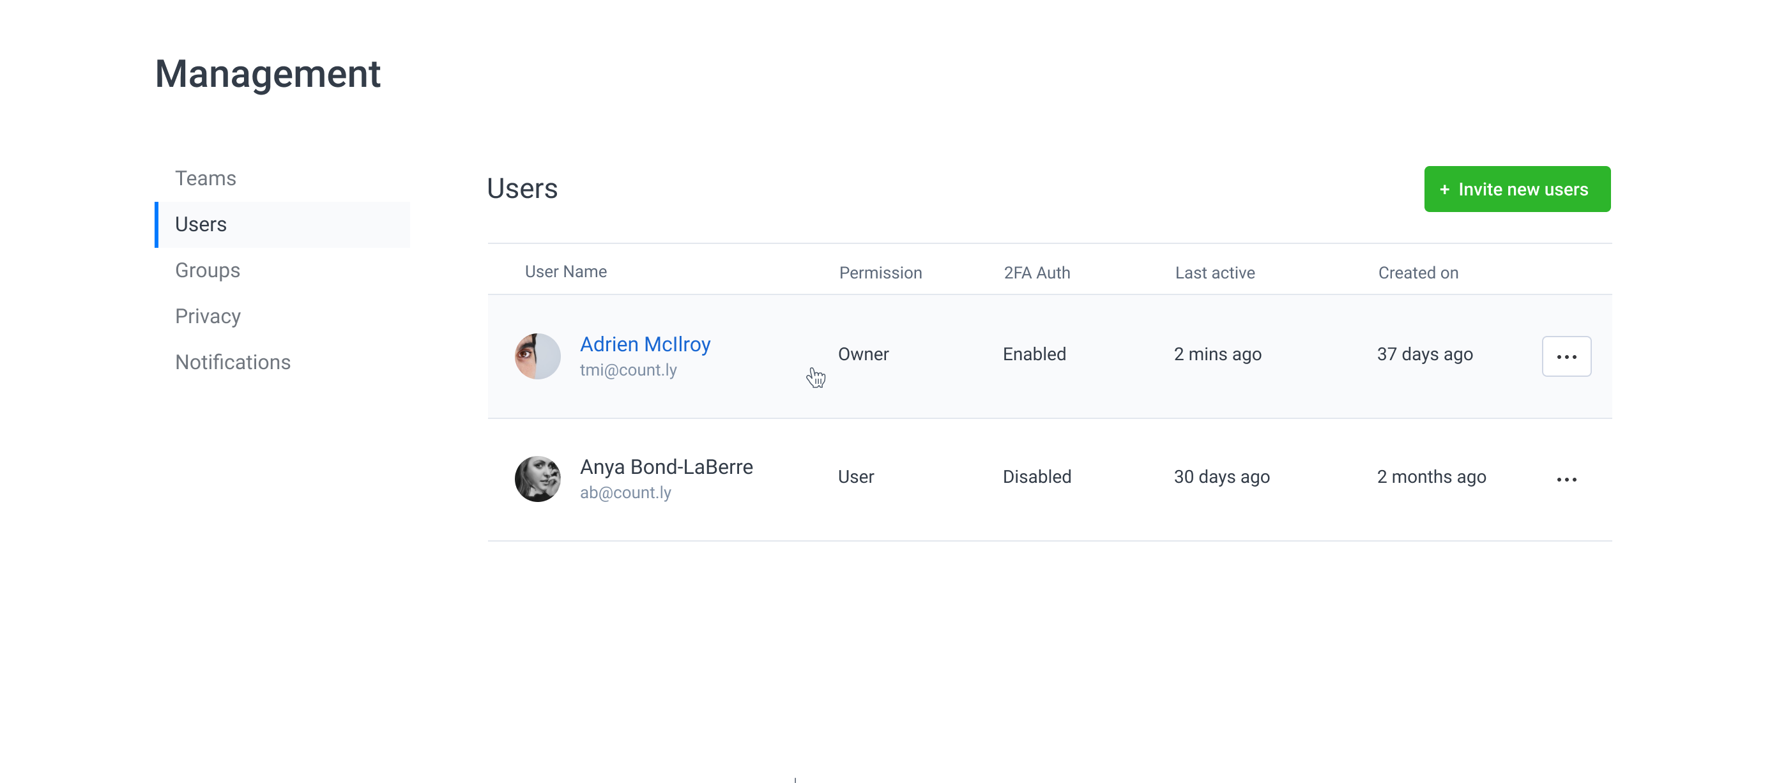
Manager
Company
Manager
Location
Brand

Slide 3
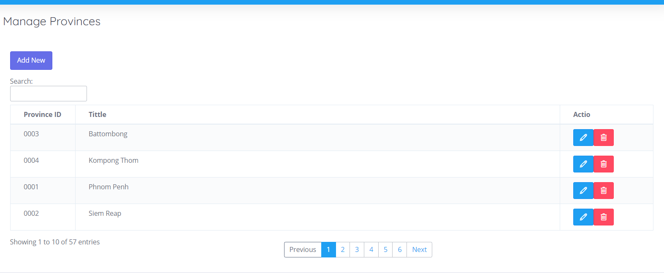
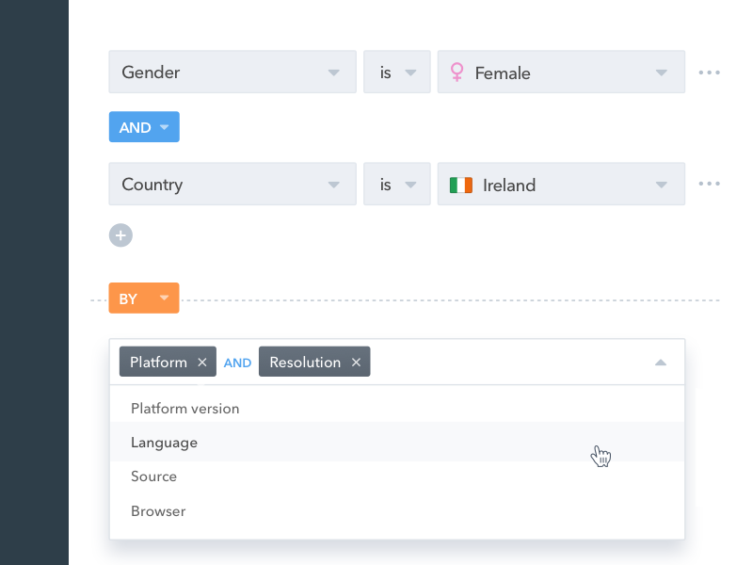
Location
Company
Manager
Location
Brand

Slide 4
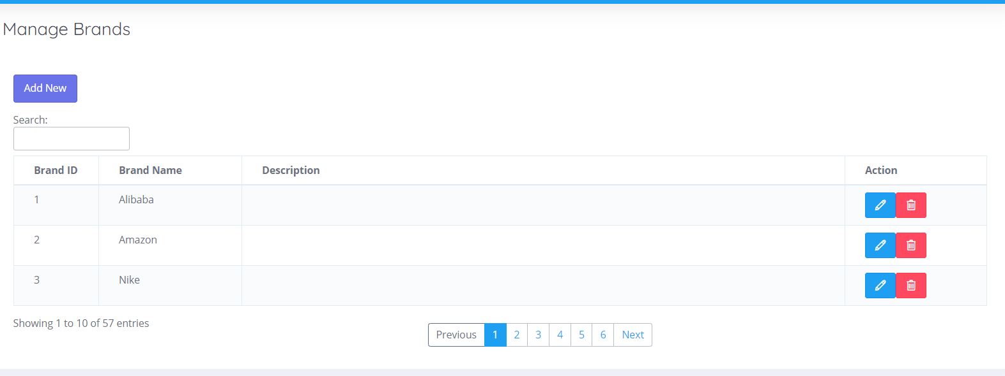
Brands
Company
Manager
Location
Brand

Slide 5
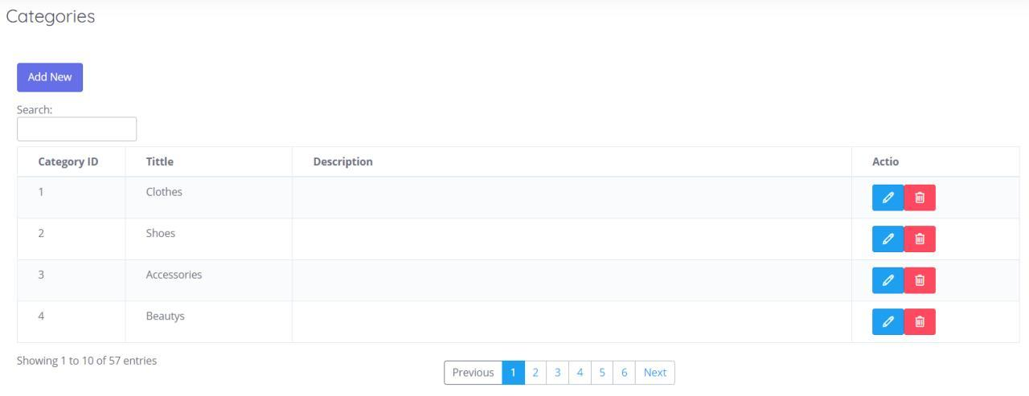
Categories
Categories
Add Categories
Update Categories

Slide 6
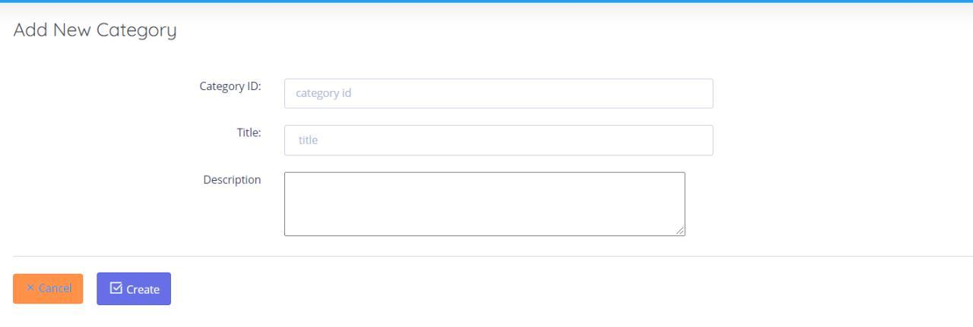
Add Categories
Categories
Add Categories
Update Categories

Slide 7
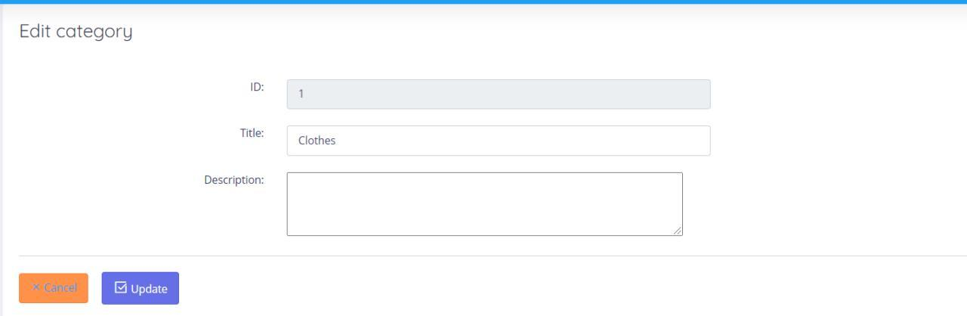
Update Categories
Categories
Add Categories
Update Categories

